Slide 1


Slide 2
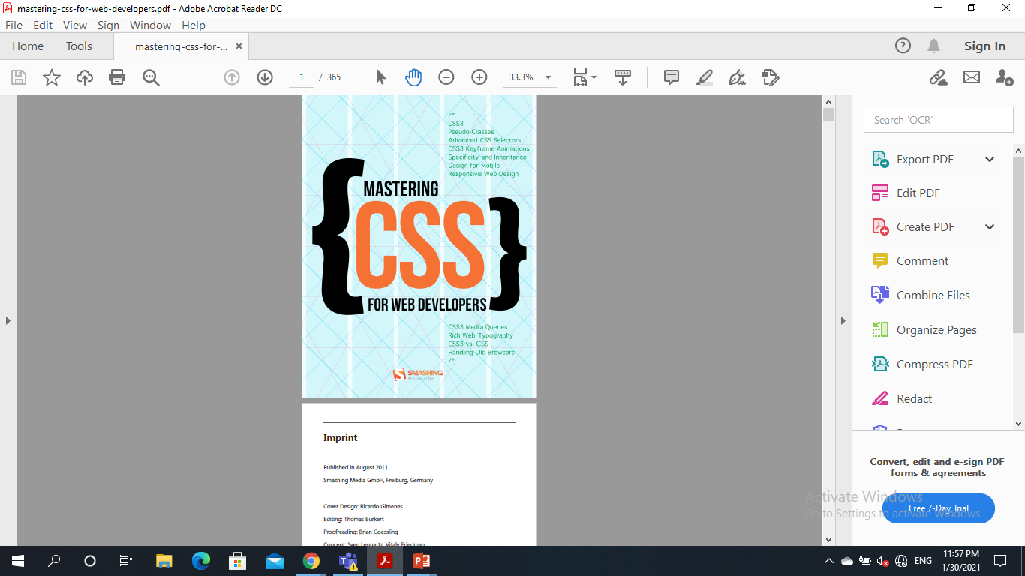
Our Book
Published in August 2011
Smashing Media GmbH, Freiburg, Germany
Cover Design: Ricardo Gimenes
Editing: Thomas Burkert
Proofreading: Brian Goessling
Concept: Sven Lennartz, Vitaly Friedman
Founded in September 2006, Smashing Magazine delivers useful and innovative information to Web designers and developers. Smashing Magazine is a well-respected international online publication for professional Web designers and developers. Our main goal is to support the Web design community with useful and valuable articles and resources, written and created by experienced designers and developers.

Slide 3
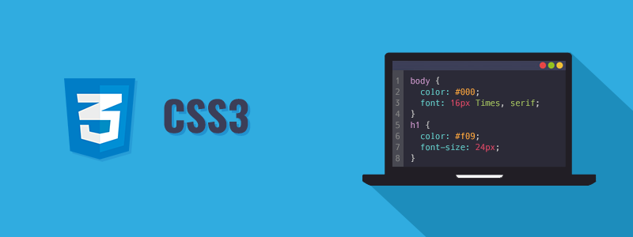
Web is one of the things that is changing and developing very quickly. Developers and designers should not wait for all web users to change their use of old browsers to new one to start implementing new technologies. They should try to adopt that some designs will not work the same in old browsers.
People generally fear change. But life in running we have the choice to chase new lives od stay in our comfort zone.

Slide 4

Connecting DOTS

Slide 5


Its all about connecting the several previous CSS properties together and be creative in using them.

Slide 6
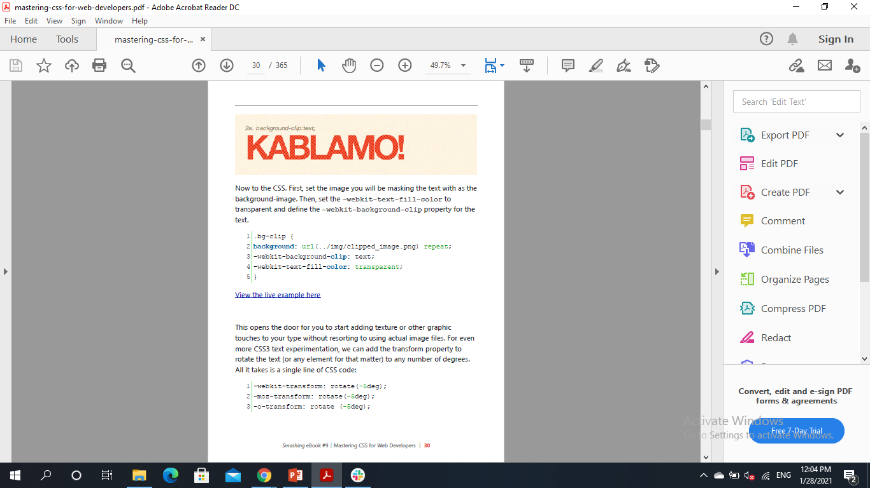
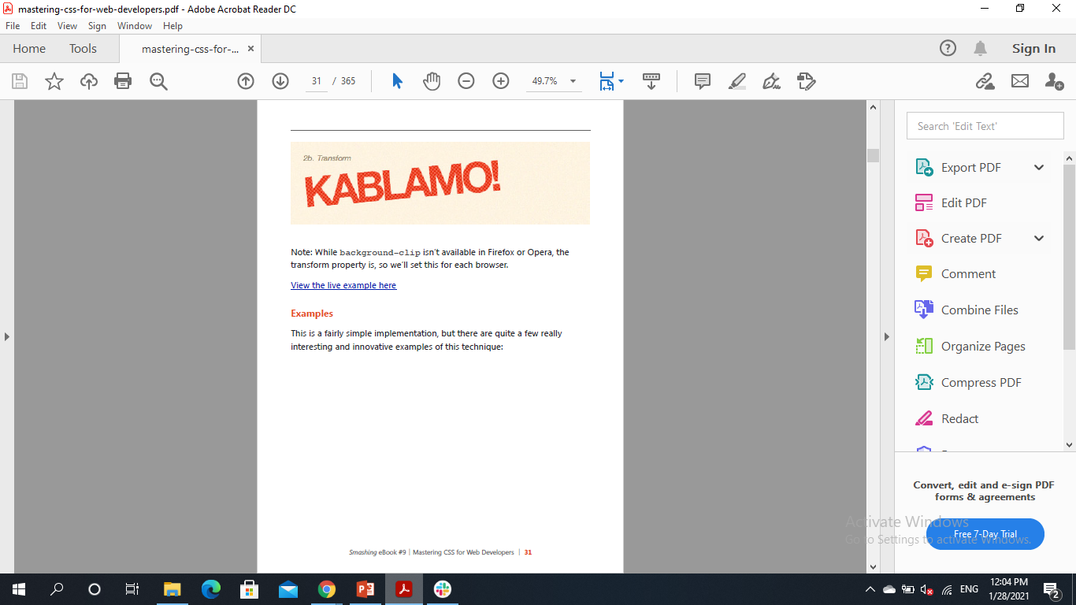
To Elaborate :
Example 1: Transition of colors on hover:
Try to choose a color for a link and apply a transition on it and see the magic.
Example 2: Perform some transformation on a background image and text.

Slide 7


Slide 8
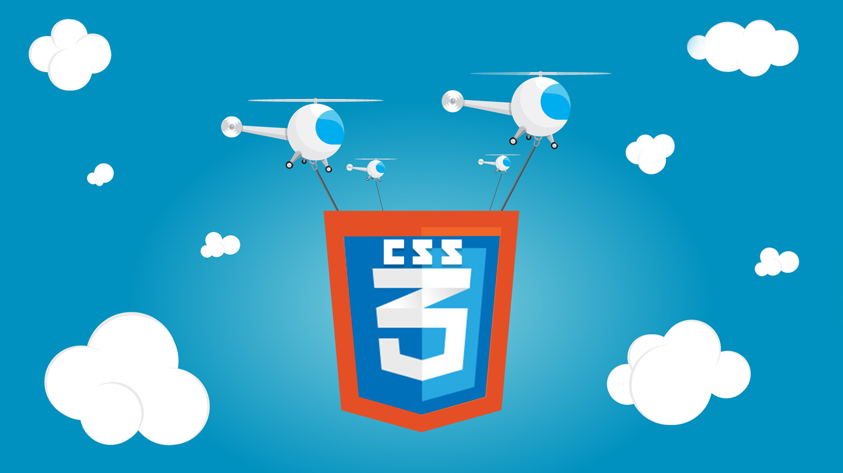
Five Essential Characteristics for Successful Modern CSS Website

Slide 9
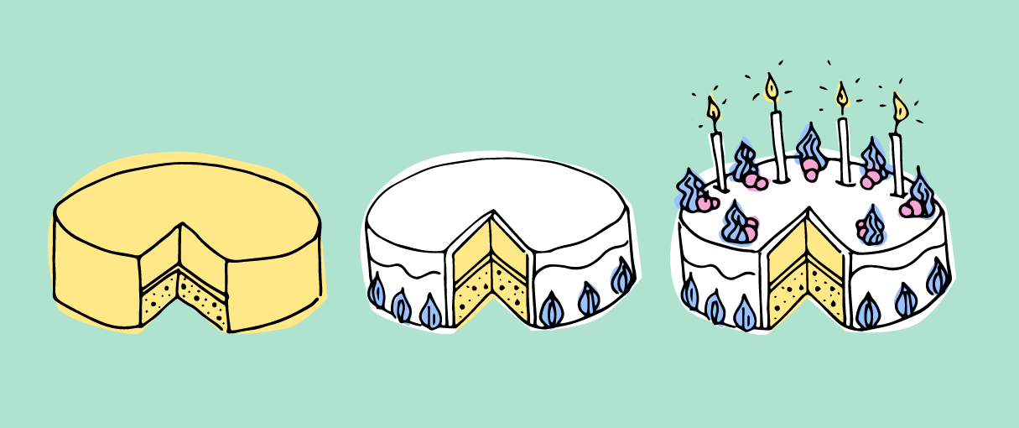
Progressive Enhancement

Slide 10
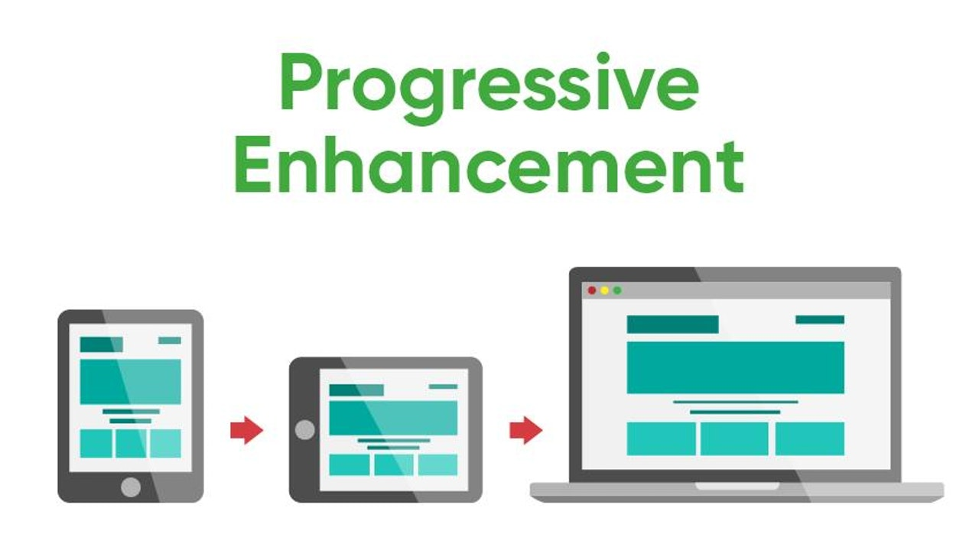
Start with a common strong “base” design that work on all browsers then you can use whatever new technologies and they will appear on new browsers without ruining them on old browsers.

Slide 11

Benefits of Progressive Enhancement:
1- More robust pages: Start with a common solid page that works on all browsers then add your new features. And not finishing your full stack website then try to fix the designs to be suitable for older browsers.
2- Happier Users: Having a clear and strong base designs for all browsers will make both users of old and new browsers happy.
3- Reduced Development Time: With progressive enhancement you won’t be sitting all the time trying to make everything the same on all browsers. And repeating all your work to adopt with old browsers.
4- Reduced Maintenance Time: Adding new features and technologies on your website while having a base for all browsers will not ruin it on old ones, but they will be added to new browsers without any problem.
5- More Fun: The fun part that new technologies will be working on new browsers without any effect on old ones.

Slide 12
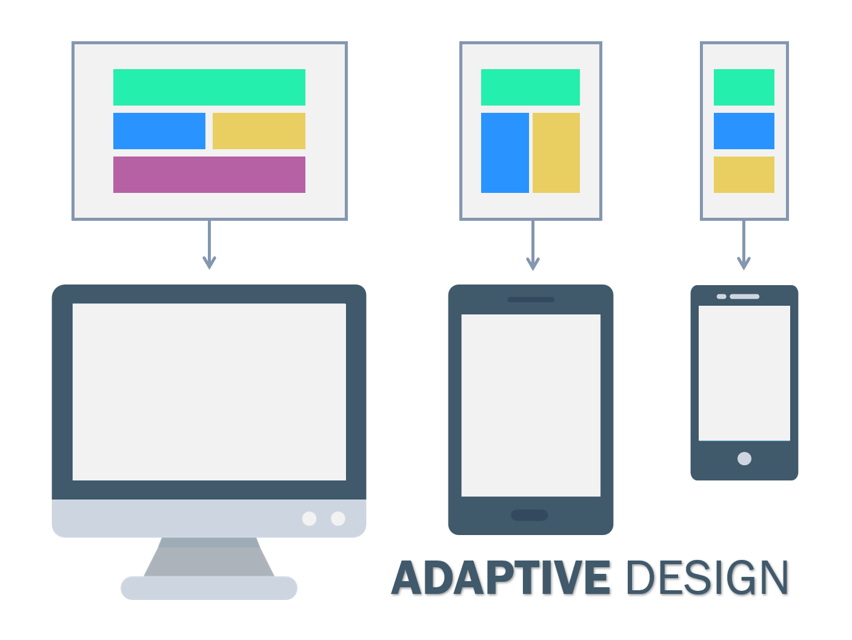
Adaptive to Diverse Users

Slide 13
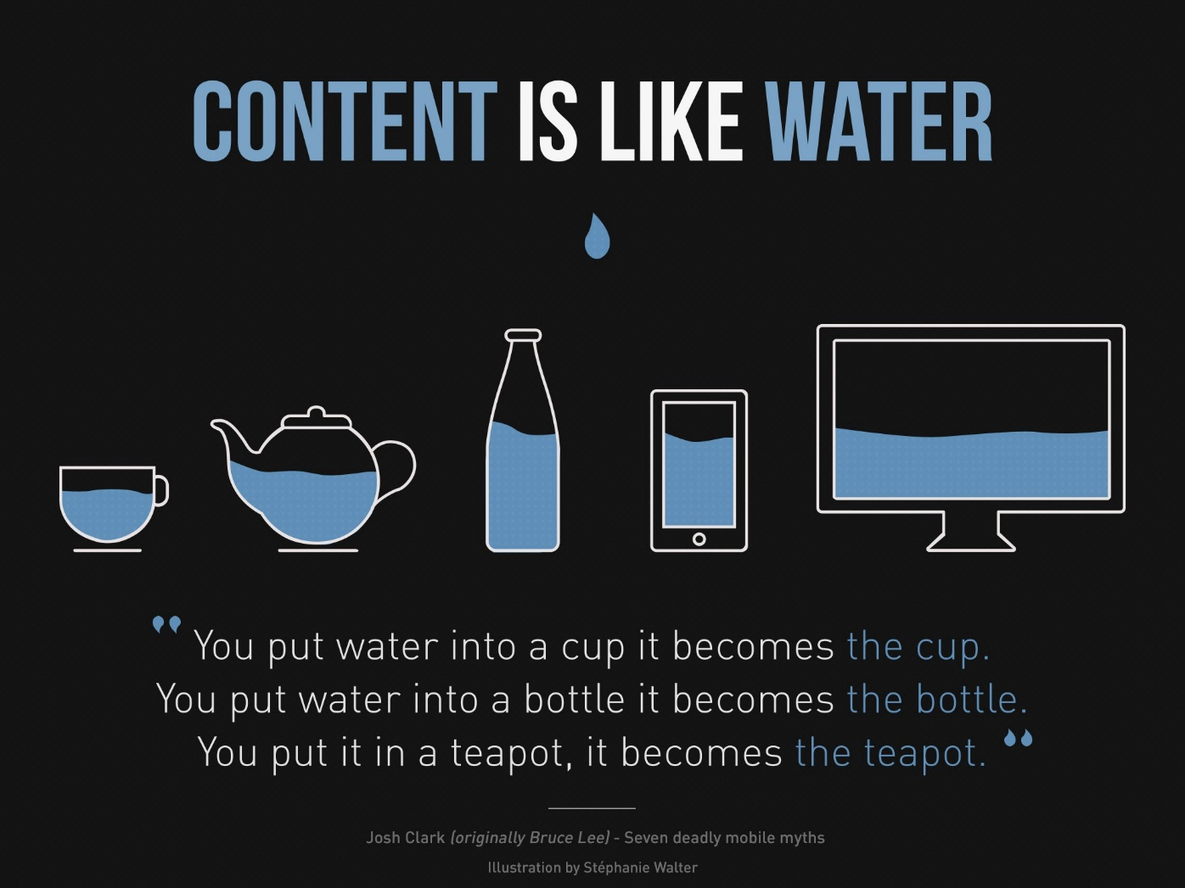
With all the diversity of browsers and device sizes that users use. CSS layouts should be more flexible now to adopt the increasing variety of users web browsers at a specific point of them.
Consider factors such as these when creating CSS layouts:
Browser
Platform
Screen Resolution
Font Sizes
Color
JavaScript Presence

Slide 14

Modular

Slide 15

Modular CSS is a collection of properties for writing code that is maintainable. So blocks of code may be used in several places among the website. This may be done by:
Creating a collection of CSS classes
Separating styles to different sheets.
Frameworks
Benefits to implement this property depends on what technique/tool we use from the above 3:
• Smaller file sizes
• Reduced development time
• Reduced maintenance time
• Easier maintenance for others
• More design flexibility
• More consistent design

Slide 16

Efficient

Slide 17

Modern CSS-based websites should be efficient in two ways: • Efficient for you to develop • Efficient for the server and browser to display to users. Its important for the website to have good performance and speed. Example on page load. And CSS3 helps that in a way that its properties reduce server calls and increase speed.

Slide 18

Rich Typography

Slide 19
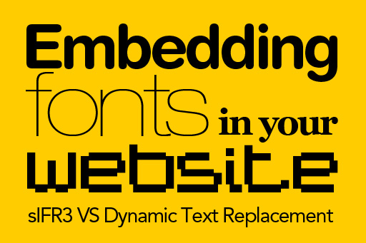
Typography is one of the most evolving areas of web design. With CSS3 new properties web designers can now use fonts that are on the server without having them on the end users’ machines which is quite nice.

Slide 20


Slide 21

The Essential Techniques and tools that will help you implement these important characteristics on your CSS-based web pages:

Slide 22
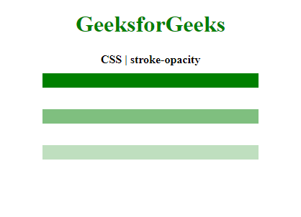

CSS Visual Effects

Slide 23
Semi-transparent Color: RGBA allows you to specify a color by not only setting the values of red, green, and blue that it’s comprised of, but also the level of opacity it should have.
Styling Backgrounds and Borders: CSS3 offers new ways to style backgrounds and borders, often without having to use images or add extra divs.
Multiple backgrounds on a single element
More control over where backgrounds are placed:
More control over where backgrounds are placed: With new background-clip and background-origin.
Background sizing: You can scale background images using the new background-size property.
Gradients
Rounded corners: Use the border-radius-property
Images for borders: Using the new border-image property

Slide 24
CSS3 Usability / Readability Enhancements

Slide 25
Creating Multiple Columns of Text: Some pieces of text are more readable in narrow, side-by-side columns, similar to traditional newspaper layout. You can tell the browser to arrange your text into columns by either defining a width for each column (the column-width property) or by defining a number of columns (the column-count property).
Controlling Text Wrapping and Breaking: CSS3 gives you more control over how blocks of text and individual words break and wrap by using: word-wrap to break-word, text-wrap , white-space-collapse.
Media Queries: CSS3′s media queries take this a step further by letting you customize styles based on the user’s viewport width, display aspect ratio

Slide 26
Improving Efficiency Through CSS3

Slide 27
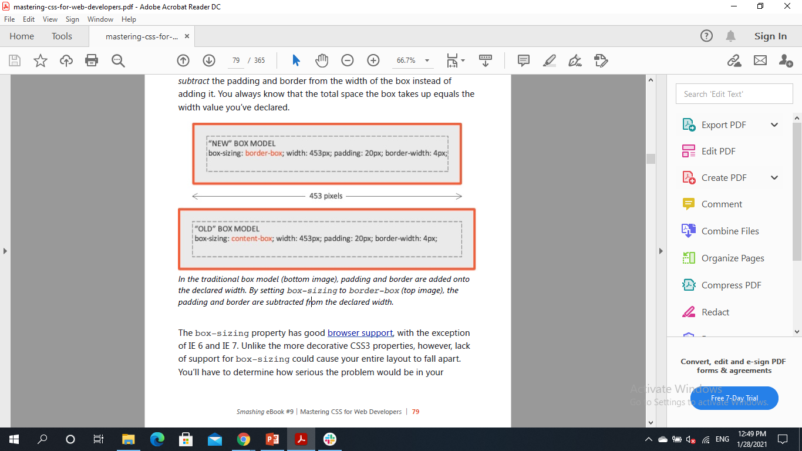
1- The box-sizing Property: The box-sizing property can help limit your div use in certain situations. Its allows us to include the padding and border in an element's total width and height.

Slide 28

2- CSS3 Pseudo-Classes: A pseudo-class is a selector that selects elements that are in a specific state.

Slide 29

3- Html5

Slide 30
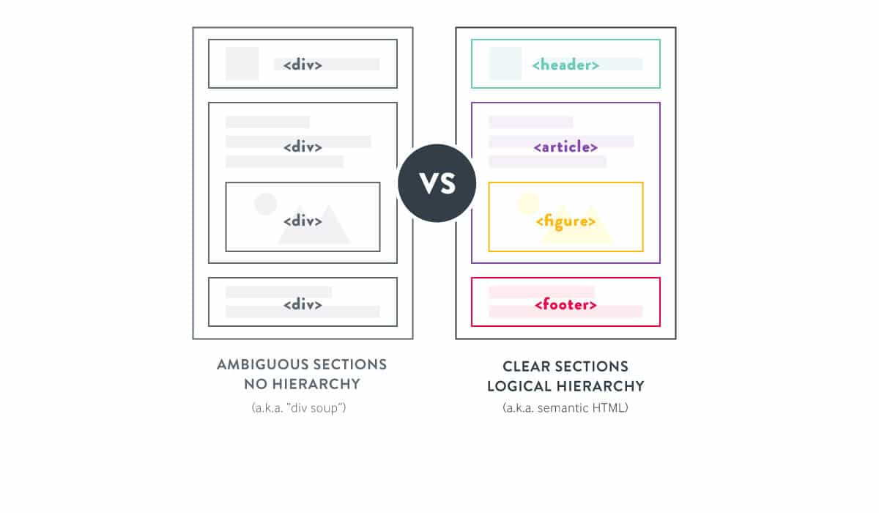
3.1- Semantics markup

Slide 31

4- Reducing JavaScript and Plug-in Dependence

Slide 32
Reducing JavaScript and Plug-in Dependence:
Some of the features that reduce JavaScript and plug-in dependence are:
• New form elements and attributes: HTML5 offers a bunch of new
input types, such as email, url, and date,
The canvas element: The canvas element creates a blank area of the
screen that you can create drawings on with JavaScript.
The video and audio elements: HTML5 can embed video and audio
files directly to the page.

Slide 33

5- Efficient CSS Development Practices
CSS Frameworks: A CSS framework is a library of styles that act as building blocks to create the standard pieces you might need in your site. Good CSS frameworks provide you with a solid starting point for your designs, cutting down your time spent developing.
Object-oriented CSS (OOCSS): The term object-oriented CSS (OOCSS) for method of creating self-contained chunks of HTML (modules) that can be reused anywhere in the page or site and that any class can be applied to.
CSS Generation

Slide 34
6- CSS Performance
CSS Compression: Writing clean CSS that takes advantage of shorthand properties, grouped selectors, and other efficient syntax is nothing new, but it remains very important for improving performance.
CSS Sprites: CSS Sprites is a CSS technique for combining many of your site’s images into one big master image and then background-position to shift the image around to show only a single image at a time. This greatly improves your pages’ performance.

Slide 35
7- Font Embedding and Replacement
The @font-face Rule: The @font-face rule, part of CSS3, allows you to link to a font on your server, called a web font.
Other Font Embedding and Replacement Techniques:
Font embedding services
Font replacement techniques

Slide 36
CSS3 Pseudo-Classes:

Slide 37
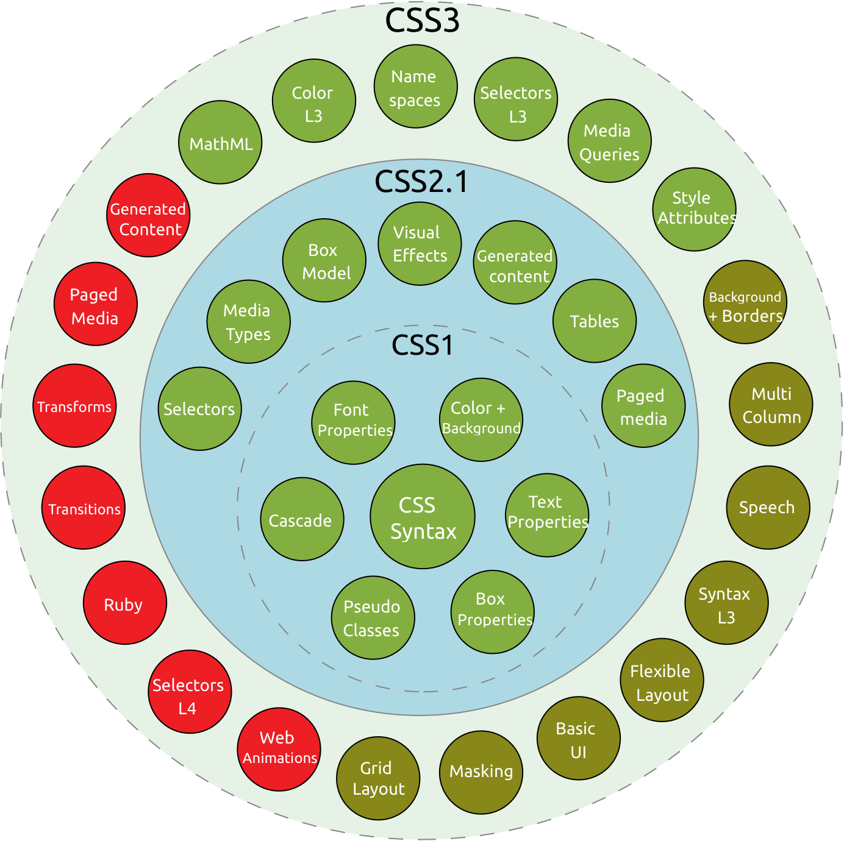
In the CSS1, a few pseudo-selectors were included. For example: { :link, :visited, :hover, :active }
In CSS2, there were exciting things like positioning were new pseudo-classes: :first-child and :lang

Slide 38
Why Use Pseudo-Classes?
What makes pseudo-classes so useful is that they allow you to style content dynamically.
The new pseudo classes allow us to dynamically style content based on its position in the document.
Sixteen new pseudo-classes have been introduced as part of the W3C’s CSS classified into four groups:
structural pseudo-classes, pseudo-classes for the states of UI elements,
target pseudo-class and a negation pseudo-class.

Slide 39
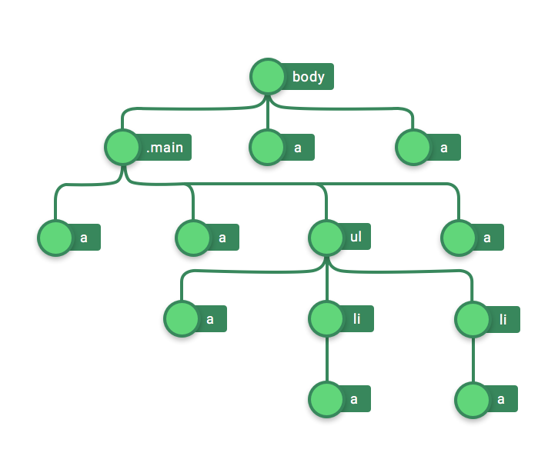
1. Structural Pseudo-Classes
CSS3 also enables us to target elements based simply on their location in the markup.
:root The :root pseudo-class selects the root element on the page.
:nth-child(n) : selector matches every element that is the nth child, regardless of type, of its parent.
:nth-last-child(n) : selector matches every element that is the nth child, regardless of type, of its parent, counting from the last child. :nth-of-type(n) : selector matches every element that is the nth child, of a particular type, of its parent.
:nth-last-of-type(n): selector matches every element that is the nth child, of a particular type, of its parent, counting from the last child.
Note: n can be a number, a keyword, or a formula.

Slide 40
Continue
:first-of-type and :last-of-type: selector matches every element that is the first child, and last child respectively of a particular type, of its parent.
Tip: This is the same as :nth-of-type(1) and nth-last-of-type(1) respectively.
:only-of-type : selector matches every element that is the only child of its type, of its parent.
:last-child : selector matches every element that is the last child of its parent.
Tip: p:last-child is equal to p:nth-last-child(1).
:only-child : If an element is the only child of its parent, then you can select it
:empty : selector matches every element that has no children

Slide 41
2. The Target Pseudo-Class
:target : selector can be used to style the current active target element, because it allows us to style elements on the page based on the URL. If the URL has an identifier (that follows an #), shares the ID with the identifier of another element then the :target pseudo-class will style the element that have the id equal to the url of the elements clicked.
3. The UI Element States Pseudo-Classes
:enabled and :disabled : selector matches every enabled, disabled element respectively.
:checked : selector matches every checked <input> element
4. Negation Pseudo-Class
:not : This is another of my favorites, because it selects everything except the element you specify.

Slide 42
CSS Specificity If there are two or more CSS rules on the same element, the browser follows some rules to determine which one is most specific and therefore will be applied. So is like a priority for which CSS style will be applied on the element.

Slide 43
Attribute selectors: Allows you to target an element based on the attribute selected. So every element having this attribute will be selected unless the value of the attribute is specified so elements with this attribute and value will be selected.
There are 6 different types of attribute selectors:
• [att=value]: The attribute has to have the exact value specified.
• [att~=value]: The attribute’s value needs to be a whitespace separated list of words (for example, class=”title featured home”), and one of the words is exactly the specified value.
• [att|=value]: The attribute’s value is exactly “value” or starts with the word “value” and is immediately followed by “-”, so it would be “value-”.
• [att^=value]: The attribute’s value starts with the specified value.
• [att$=value]: The attribute’s value ends with the specified value.
• [att*=value]: The attribute’s value contains the specified value.

Slide 44
2. Child selector: The child selector is represented by the sign “>”. It allows you to target elements that are direct children of a particular element.
3. Sibling combinators: There are two types of sibling combinators: adjacent sibling combinators and general sibling combinators.
Adjacent sibling combinator: This selector uses the plus sign, “+”, to combine two sequences of simple selectors. The elements in the selector have the same parent, and the second one must come immediately after the first.
The element + element selector is used to select an element that is directly after another specific element.
General sibling combinator: Its works the same as Adjacent sibling combinator but with the difference that the second selector doesn’t have to immediately follow the first one.
The element1~element2 selector matches occurrences of element2 that are preceded by element1.
Both elements must have the same parent, but element2 does not have to be immediately preceded by element1.
4,5,6,7- Pseudo-classes: We can combine these selectors with all the types of Pseudo-classes elements.

Slide 45
8. Pseudo-elements: Pseudo-elements allow you to access elements that don’t actually exist in the HTML. CSS 3 specifications state that they should be used with the double colon “::”, to distinguish them from pseudo-classes.
::first-line : elector is used to add a style to the first line of the specified selector. It can only be used with block-level elements.
::first-letter : selector is used to add a style to the first letter of the specified selector.
::before and ::after : The ::before and ::after pseudo-elements are used to insert content before or after an element’s content, purely via CSS. These elements will inherit many of the properties of the elements that they are being attached to.
!important gives more weight for the CSS rule. So it disrupts the natural flow of your rules, giving more weight to rules that are undeserving of such weight.
So its important to know where you use it.

Slide 46

We should be noted that some of these selectors are not supported in Internet Explorer 7 and before.

Slide 47

An Introduction to CSS3 Keyframe Animations
Using CSS3 keyframe animations, developers can create smooth,
maintainable animations that perform relatively well and that don’t require reams of scripting.

Slide 48
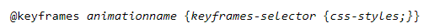
The Keyframe @ Rule
The @keyframes rule specifies the animation code.
During the animation, you can change the set of CSS styles many times.
The @ rule and its identifier are then followed by a number of rule sets (style rules with declaration blocks, as in normal CSS code).
The Keyframe Selectors
keyframes-selector | Required. Percentage of the animation duration. OR values: 0-100% from (same as 0%) to (same as 100%)

Slide 49
Associating The Animation Name With An Element
We can associate the animation to a specific element by using any element selector then adding the animation name to it.
The Animation’s Duration And Timing Function
Duration and timing can be added to the animation. Duration using the animation-duration property. The duration represents the time taken to complete a single iteration of the animation.
The animation-timing-function property, when declared for the entire animation, allows you to define how an animation progresses over a single iteration of the animation. The
The Animation’s Delay And Play State
The animation-delay property allows you to delay the animation by a certain amount of time.
The animation-play-state property, accepts one of two possible values: running and paused.

Slide 50
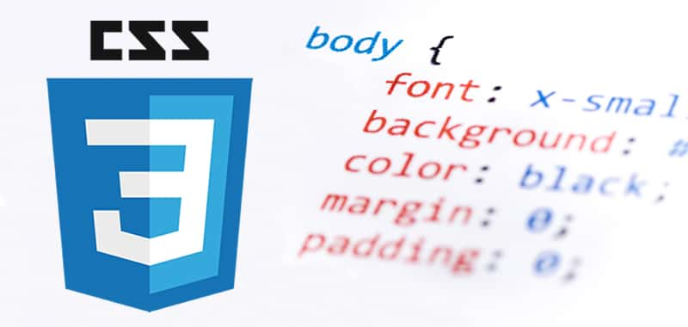
CSS Specificity and Inheritance

Slide 51

1. Importance
Cascade assigns a weight to each rule, and this weight determines which rule takes precedence, when more than one applies.
1. User agent declarations
2. User declarations
3. Author declarations
4. Author !important declarations
5. User !important declarations

Slide 52
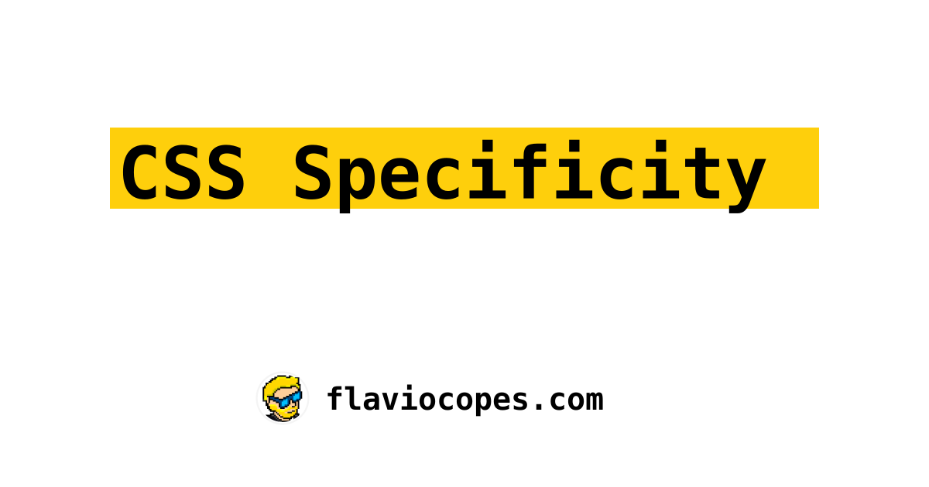
2. Specificity
Every CSS rule has a particular weight meaning it could be more or less important than the others or equally important. This weight defines which properties will be applied to an element when there are con
if one rule is more specific than another, it overrides it.
If two rules share the same weight, source and specificity, the later one is applied.
It can be calculated in 2 ways:
Add 1 for each element and pseudo-element ; add 10 for each attribute, class and pseudo-class; add 100 for each ID; and add 1000 for an inline style.
Start with a=0, b=0, c=0 and d=0 and replace the numbers accordingly:
• a = 1 if the style is inline
• b = the number of IDs
• c = the number of attribute selectors, classes and pseudo-classes
• d = the number of element names and pseudo-elements

Slide 53
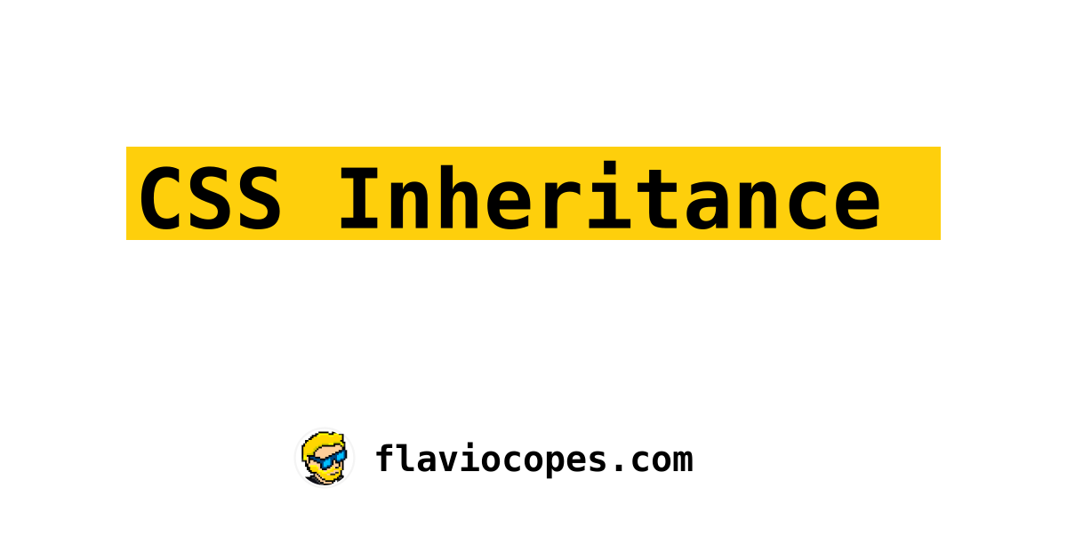
3. Inheritance
Inheritance is a way of propagating property values from parent elements to their children.
The CSS specification determines whether each property is inherited by default or not. Not all properties are inherited, but you can force ones to be by using the inherit value.
Every CSS property goes through a four-step process when its value is being determined:
1. Specified value The user agent determines whether the value of the property comes from a style sheet, is inherited or should take its initial value.
2. Computed value The specified value is resolved to a computed value and exists even when a property doesn’t apply. The document doesn’t have to be laid out for the computed value to be determined
3. Used value The used value takes the computed value and resolves any dependencies that can only be calculated after the document has been laid out.
4. Actual value This is the value used for the final rendering, after any approximations have been applied

Slide 54
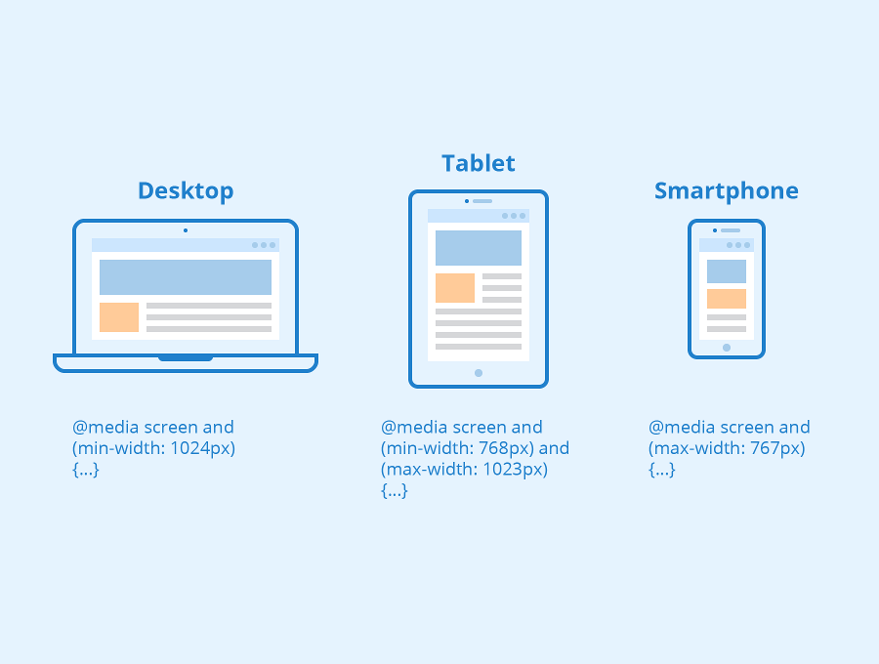
How to Use CSS3 Media Queries to Create a Mobile Website

Slide 55
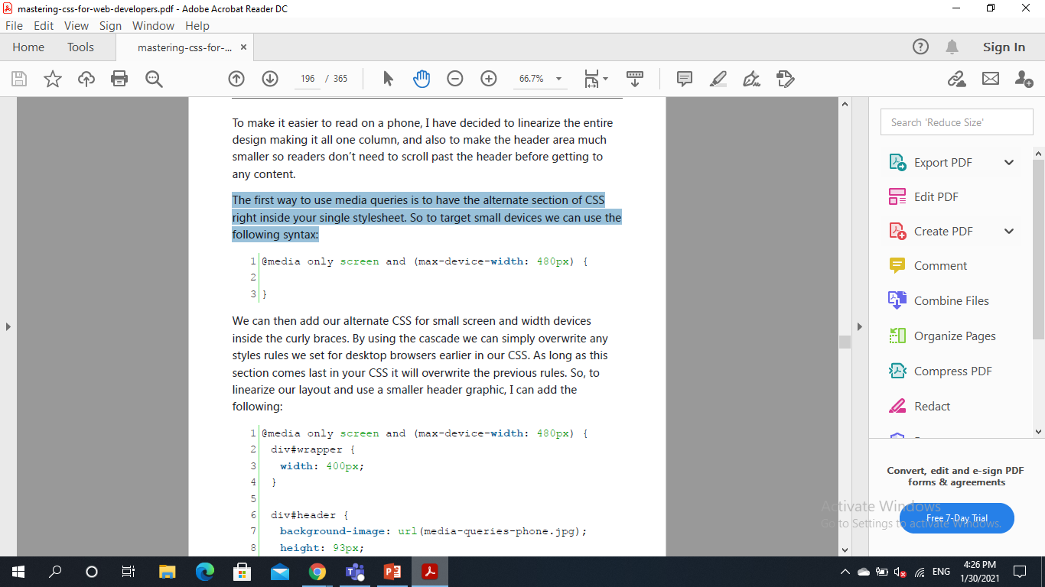
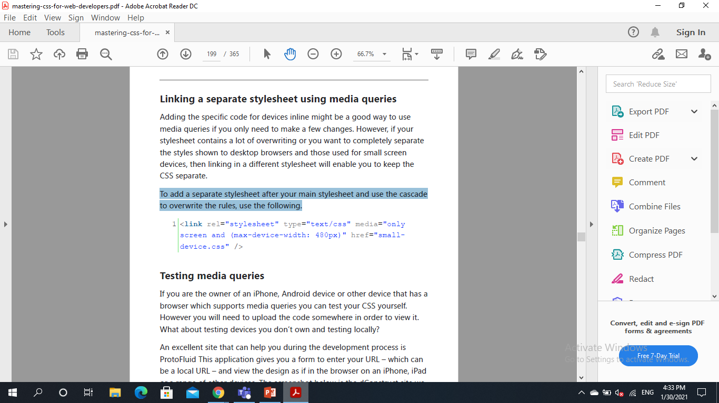
Media queries are used to apply different styles for different media types/devices. Media queries can be used to check many things, such as: width and height of the viewport, device, orientation, resolution
Using media queries are a popular technique for delivering a tailored style sheet (responsive web design) to desktops, laptops, tablets, and mobile phones.
The first way to use media queries is to have the alternate section of CSS right inside your single stylesheet. So to target small devices we can use the following syntax:
You add a separate stylesheet after your main stylesheet and use the cascade to overwrite the rules, use the following.

Slide 56

Responsive Web Design: What It Is and How to Use It
Responsive web design is about creating web pages that look good on all devices!
A responsive web design will automatically adjust for different screen sizes and viewports.

Slide 57
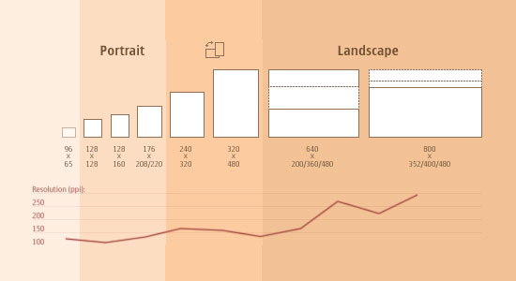
Adjusting Screen Resolution
With the increase of new devices with different screen sizes and several options to toggle between landscape and portrait mode.
Websites should adapt and work on almost all devices size that users are using now and aiming to use your website.
One solution would be to create custom designs for each size but that will not be efficient with the everyday new properties od smart phones and devices.

Slide 58
Flexible Everything
Flexible Images:
Resizing images to adapt to all device sizes proportionally.
One method is to use max-width property to be equal to 100%.
Custom Layout Structure.
In the style sheet we can add a child style sheet to customize the design of elements on smaller device sizes. As mentioned before. Another solution is to use media queries with the loads of new features in it we can style and the elements on smaller devices. And this is the most efficient way.
JavaScript:
Another method that can be used is JavaScript, especially as a back-up to devices that don’t support all of the CSS3 media query options. Fortunately, there is already a pre-made JavaScript library that makes older browsers support CSS3 media queries.

Slide 59
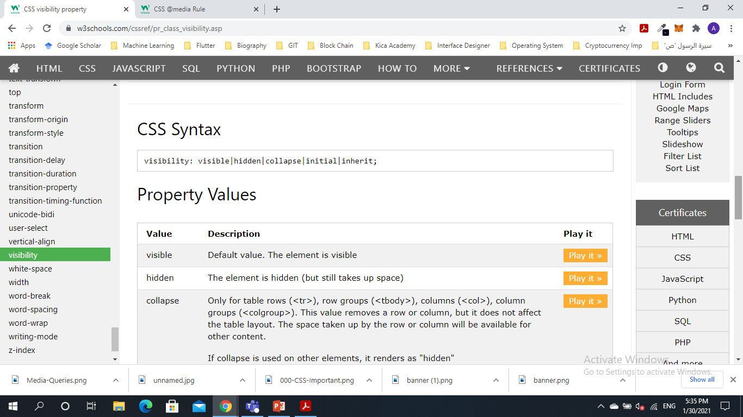
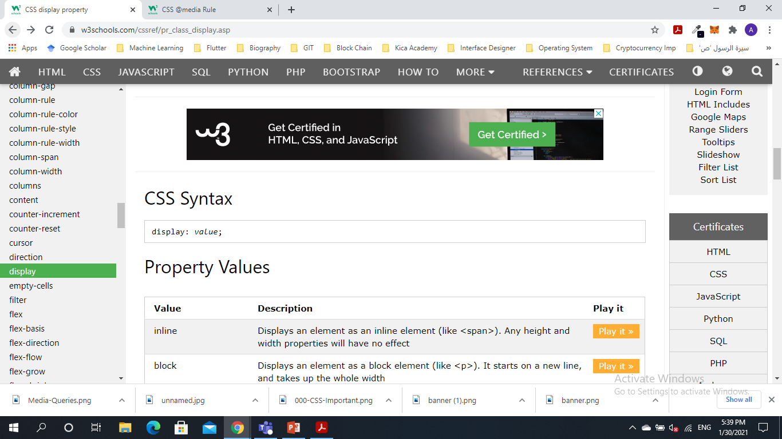
Showing or Hiding Content
Responsive Web design shouldn’t be just about how to create a flexible layout on a wide range of platforms and screen sizes. It should also be about the user being able to pick and choose content. Fortunately, CSS has been allowing us to show and hide content very easily.
Sometimes, we want elements to be seen on big sizes and others on small sizes.
Two available options:
1- visibility property specifies whether or not an element is visible. Hidden elements take up space on the page.
2- display property specifies the display behavior of an element. Its is used to both hide and remove an element from the document layout!

Slide 60

Technical Web Typography: Guidelines and Techniques

Slide 61
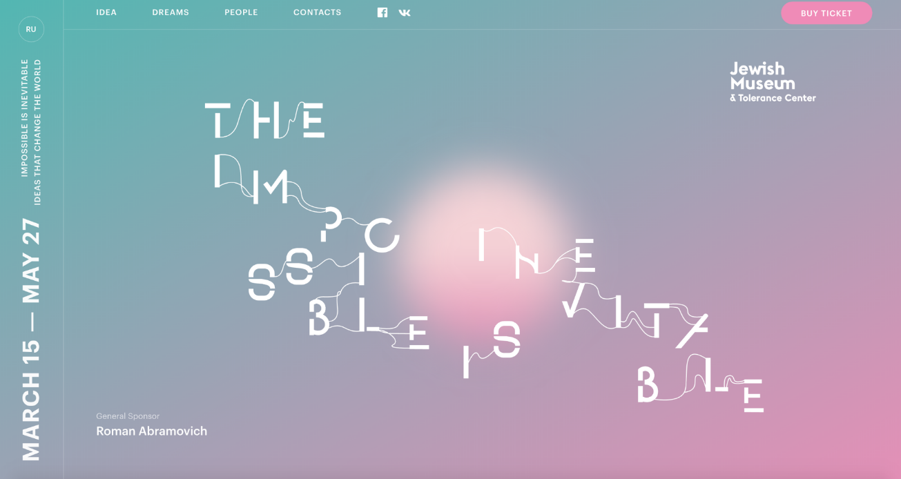
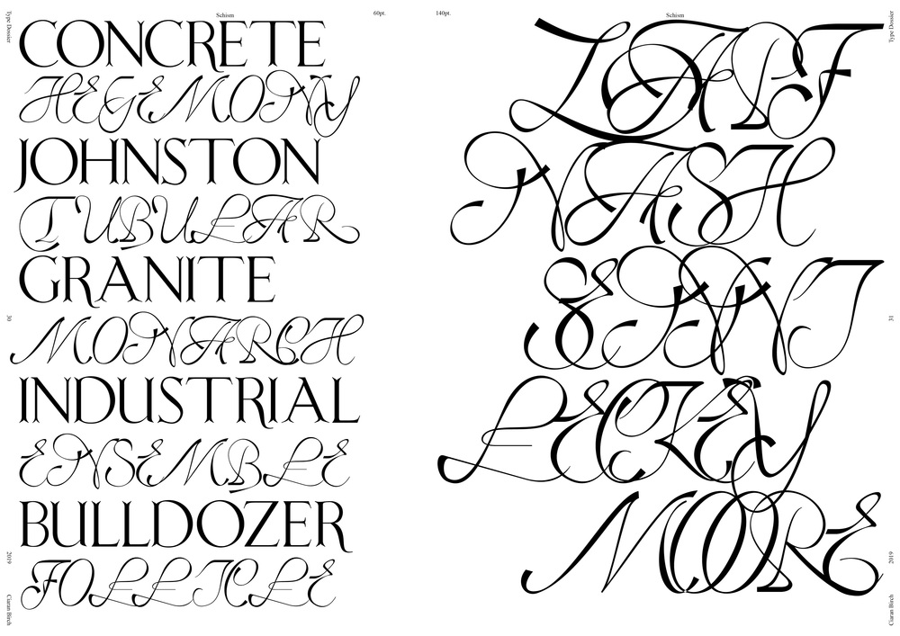
Beside the color, images, mood of the website designers must take into consideration the typography of their website from font type, size, family.

Slide 62
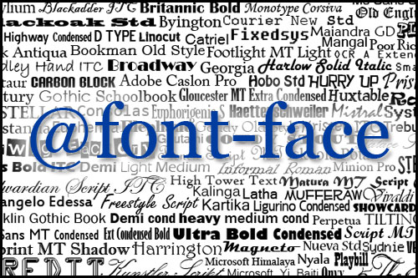
Choosing A Font Face
Choosing the font type can be tricky since every type can convert the mood of the website.
For example:
Cambria is a beautiful font, specifically designed for on-screen reading.
Plus, font size also plays a big role it the interface of the design.

Slide 63
Proper Quotations Marks, Dashes And Ellipses
Quotation Marks: Keyboard quotations are actually not the real quotations to use for quotes for example. There are four values for the content property that relate to the quotes.
Which Quotation Marks Should You Use?
The type of quotation marks to use (double or single) varies from country to country and style guide to style guide. Double quotation marks are typically used to quote a written or spoken source, and single quotation marks are used for quotes within quotes.
Ellipsis: An ellipsis is used to denote a thought trailing off. It is also used as a placeholder for omitted text in lengthy quotations. The ellipsis is displayed inside the content area, decreasing the amount of text displayed. If there is not enough space to display the ellipsis, it is clipped. An ellipsis is not three dots. It is one glyph that looks like three dots.

Slide 64
The Future of CSS Typography
The Font Property:
Instead of specifying each property separately, you can do it all in one go using the font shorthand property. The order of the properties should be as follows: font-style, font-variant, font-weight, font-size, line-height, font-family.
When using the font shorthand, any values not specified will be replaced by their parent value.
Dealing With White Space, Line Breaks And Text Wrapping:
White Space: The white-space property lets you specify a combination of properties for which it serves as a shorthand: white-space-collapsing and text-wrap.
Word Wrap: property allows long words to be able to be broken and wrap onto the next line.
Word And Letter Spacing:
letter-spacing property increases or decreases the space between characters in a text.
word-spacing property increases or decreases the white space between words.
Text-indent: property specifies the indentation of the first line in a text-block. Negative values are allowed. The first line will be indented to the left if the value is negative.

Slide 65
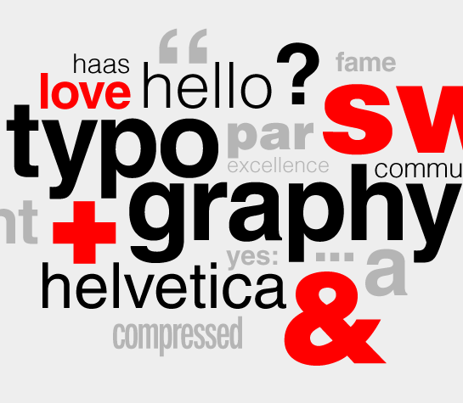
Web Fonts And Font Decoration

Slide 66
@font-face rule you must first define a name for the font, and then point to the font file.
text-shadow: text-shadow property adds shadow to text.
This property accepts a comma-separated list of shadows to be applied to the text.
New Text-Decoration Properties:
text-decoration-line: Takes the same values as text-decoration: none, underline, overline and line-through.
text-decoration-color: Specifies the color of the line of the previous property.
text-decoration-style: Takes the values of solid, double, dotted, dashed and wave
text-decoration: The shorthand for the three preceding properties.
Controlling Overflow: text-overflow property lets you control what is shown when text overflows its container.

Slide 67

There are two approaches in creating website Graceful Degrade and Progressive Enhancement. Already discussed. But Progressive Enhancement stands for creating a design that works on almost every version of browsers. While, Graceful Degrade works on full option design for modern browsers.
With the development of technologies, and with users still using old browser, fallback are implemented in order to guarantee that old browsers’ users still have the possibility to use the website.
But almost all the possible solutions to implement fallbacks depends on javascript.
Using CSS3 is the future of the Web, no argument about that. So, versing yourself right now in the language of the future makes sense. While IE is still the single most popular browser, it now has less than half of the market share, meaning that the majority of people no longer use it and it can no longer be used as an excuse not to explore new possibilities and opportunities.

Slide 68
The Authors:
Christian Krammer
Dave Sparks
Harry Roberts
Kayla Knight
Inayaili de Leon
Louis Lazaris
Rachel Andrew
Richard Shepherd
Trent Walton
Vitaly Friedman
Zoe Mickley Gillenwater

Slide 69

Anissa Al Amin

